Slide 1
ML-Process-Prioritizer — Smarter OS Scheduling Using Machine Learning
Build a simulation platform that models OS-level process scheduling using real-time machine learning-based priority prediction. Combine intelligent backend logic with a dynamic frontend for live visualization of process execution and resource management.

Slide 2
Updated Workflow / Architecture
Backend (Flask, Python):
Manages simulation and ML-based priority prediction
Trained RandomForest model (via scikit-learn)
Serves JSON data for live UI updates
Frontend (HTML, JS, CSS):
Visual process table & dashboard
Animated state transitions
User parameters (aging interval, no. of processes)
Communication:
REST APIs using Fetch & AJAX
Real-time JSON sync (process_table.json, run_stats.json)

Slide 3
Technical Progress
Machine Learning
Dataset prepared, features engineered: cpu_util, mem_usage, sys_load, age
Trained RandomForest model (90%+ accuracy)
Simulation Engine
Implemented simulate.py: state transitions, resource allocation, aging
ML integrated to predict priorities dynamically
Frontend
Real-time dashboard, animated transitions, state cards
Configurable controls (start, parameters)
Backend Integration
Flask API: start/stop simulation, serve data
JSON output for live updates

Slide 4
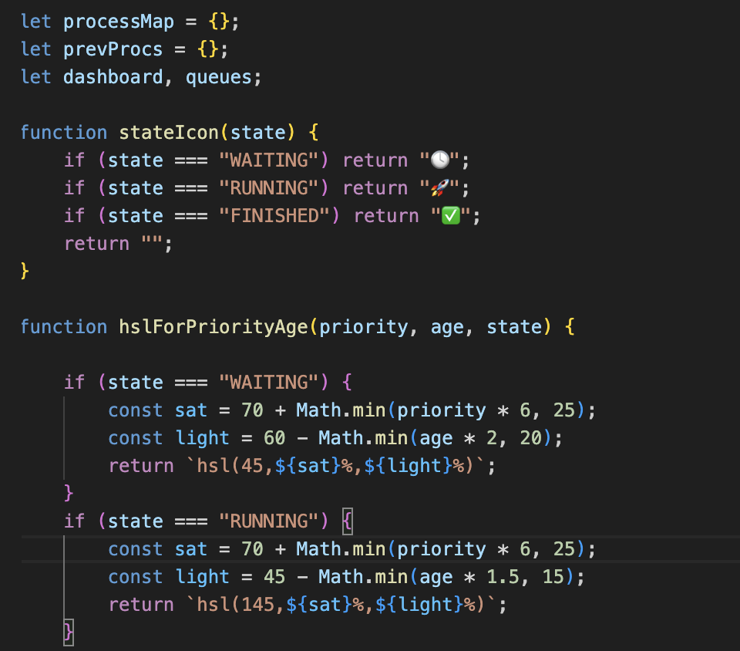
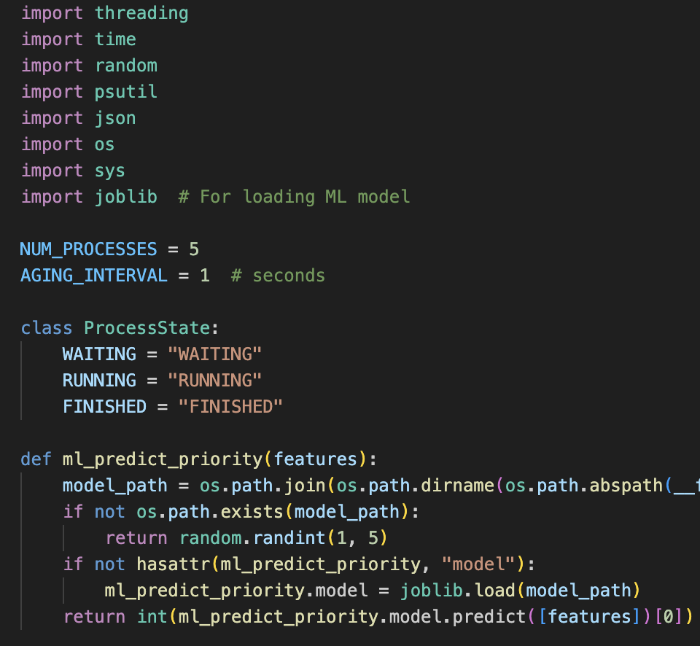
Screenshots / Code Snippets

Slide 5
Role-wise Contributions
Task Completed | Team Member
Machine Learning Model: 1.Designed and implemented the ML pipeline for process priority prediction (train_priority_model.py). 2.Prepared and managed the dataset (process_data.csv), including feature engineering (cpu_util, mem_usage, sys_load, age). 3.Integrated the trained model into the simulation for real-time priority prediction. 4.Simulation Logic: •Developed core simulation logic in simulate.py, including process state management, aging, and resource allocation. | Aditya Bisht
Frontend & Visualization: 1.Built the live process table and animated visualization in visualize.js and main.js. 2.Implemented real-time updates and smooth transitions for process states (WAITING, RUNNING, FINISHED). 3.Ensured user interactions (starting simulation, adjusting parameters) are intuitive and responsive. | Hirdyanshu
Flask Server & API: 1.Developed the Flask backend in server.py to manage simulation processes and serve static files. 2.Handled API endpoints for starting simulations and serving data to the frontend. 3.Managed process lifecycle (starting, terminating simulations) and ensured robust backend operation. | Samarth Jasta
HTML AND CSS: 1.Developed index.html file for basic structure or skeleton of UI. 2.Added basic styling like colours, fonts, or spacing in the CSS to make the dashboard look cleaner and more readable. 3. Write or improve the README section about the UI. | Himakshi Bhakuni

Slide 6
Testing & Challenges
Tests Passed:
ML model validation – 90%+ accuracy
UI/UX functionality – manual validation
Backend-to-Frontend sync via JSON – working
Challenges Solved:
ES module issue with visualize.js and main.js (resolved by converting to <script type="module">)
DOM loading sequence fixed for live updates

Slide 7
What's Next & Final Status
Core system complete — ML model + simulation + UI JSON sync, state transitions, dashboard working Round Robin scheduling, Gantt chart (stretch goals) More visual analytics, multi-core simulation

